Slide 1
Digital Archival Tracker
Mid-Term Presentation

Slide 2
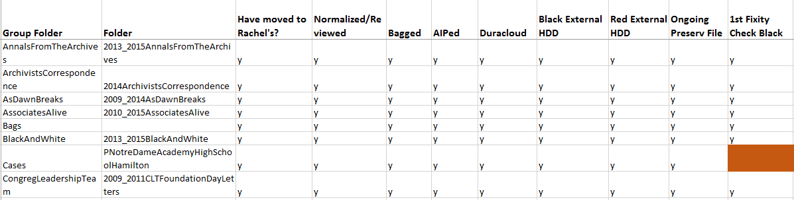
Existing System

Slide 3
Few Important Technologies
C# .NET, WPF – Windows Presentation Forms, Visual Studio
uniVocity, Java
SQLite

Slide 4
Problem Statement
Manually reading fixity reports
Maintaining the tracking data in a separate spreadsheet

Slide 5
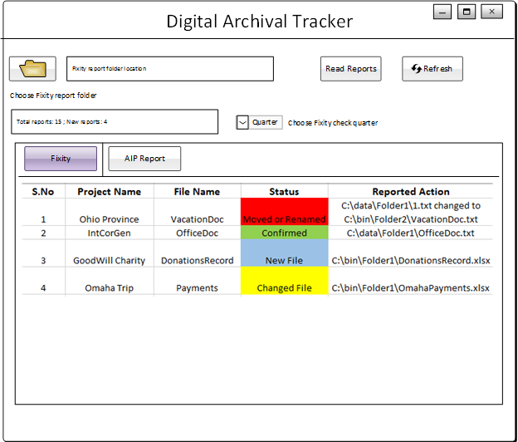
Overview of the System
Eliminates the complexity of understanding a report generated by fixity
In addition, it provides features to comment and annotate which are stored in database

Slide 6
Product Functionalities
Displaying of Fixity report data based on quarters
Clear Presentation of Fixity & AIP Reports
Commenting and Annotating on AIP Report

Slide 7
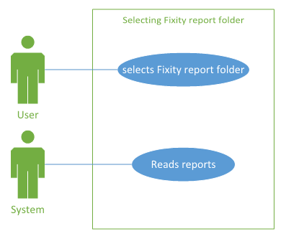
Use Cases for User Interface

Slide 8
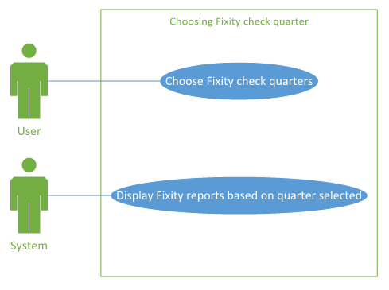
Use Cases for User Interface

Slide 9
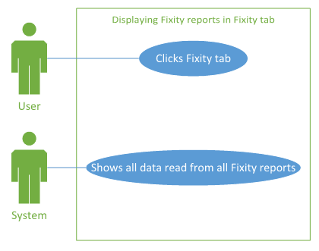
Use Cases for User Interface

Slide 10
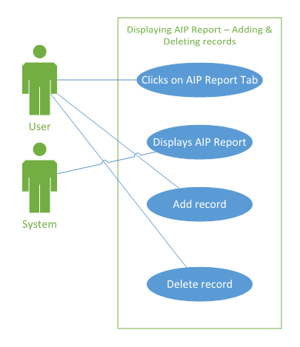
Use Cases for User Interface

Slide 11
Display Fixity Report Data

Slide 12
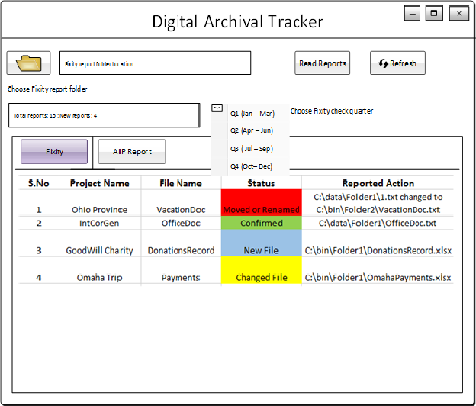
Choose Fixity Check Quarter

Slide 13
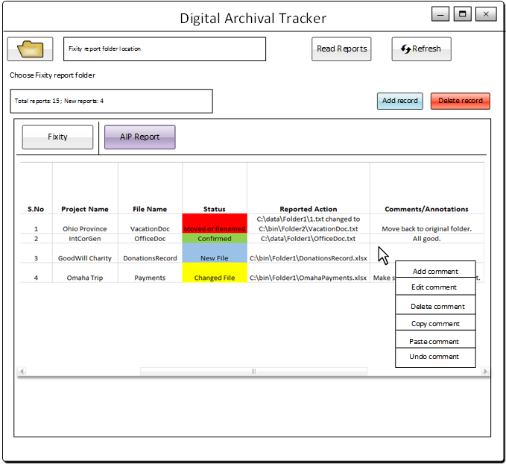
Adding Comments to AIP Report

Slide 14
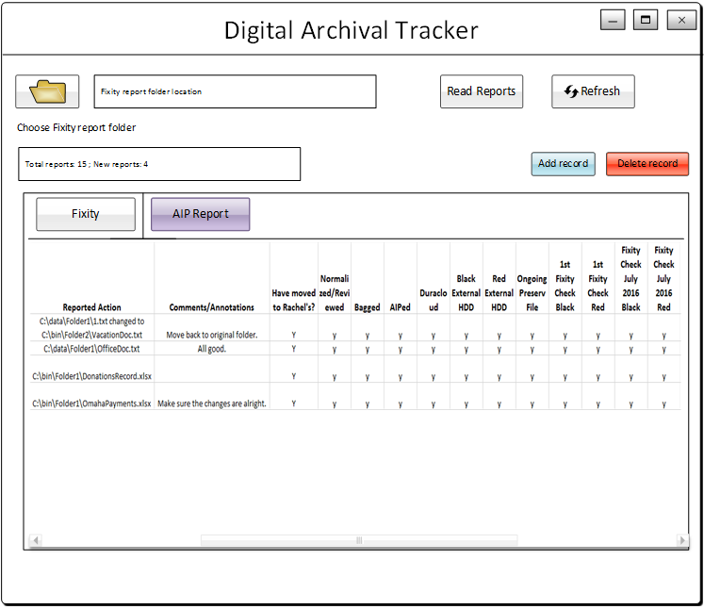
Displaying Additional Columns in AIP Report

Slide 15
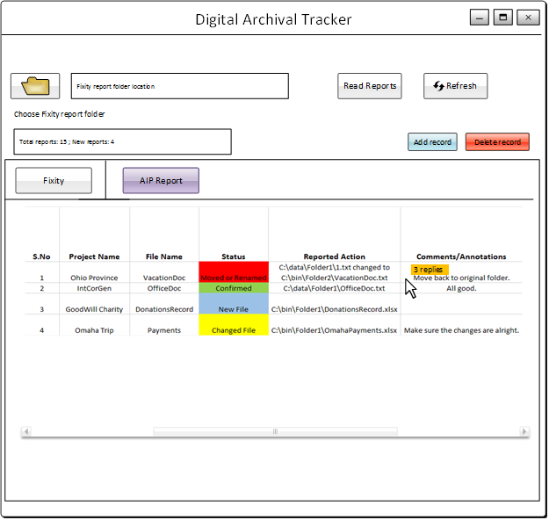
Displaying Reply Counter by Hovering Mouse in Comment Column

Slide 16
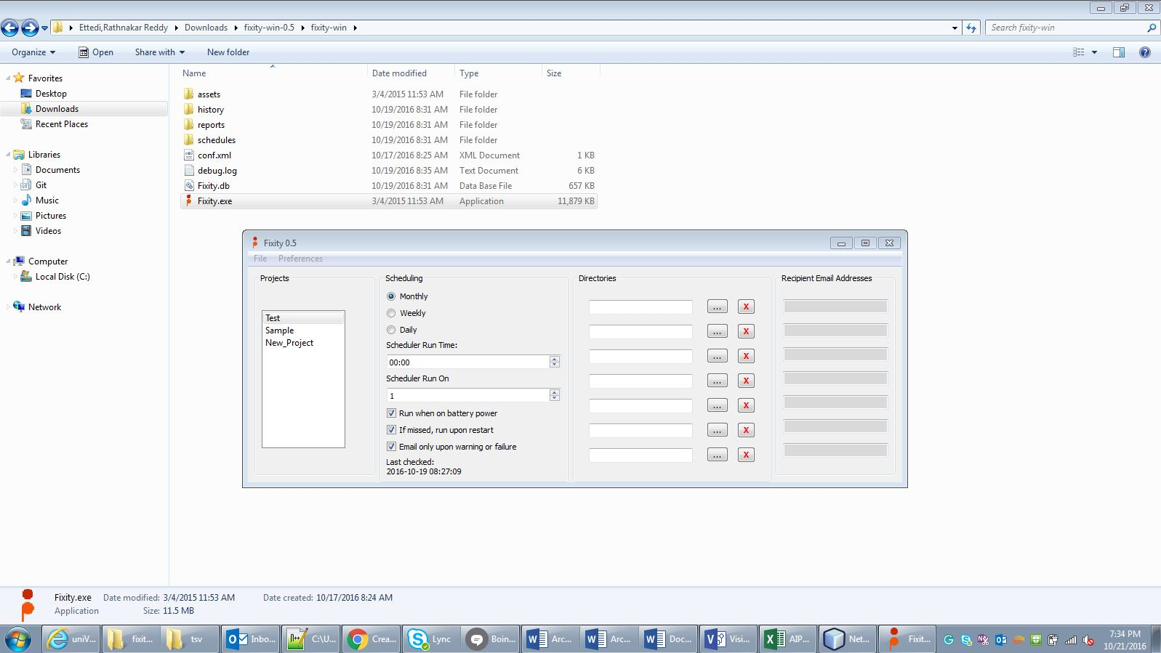
Fixity Tool Understanding

Slide 17
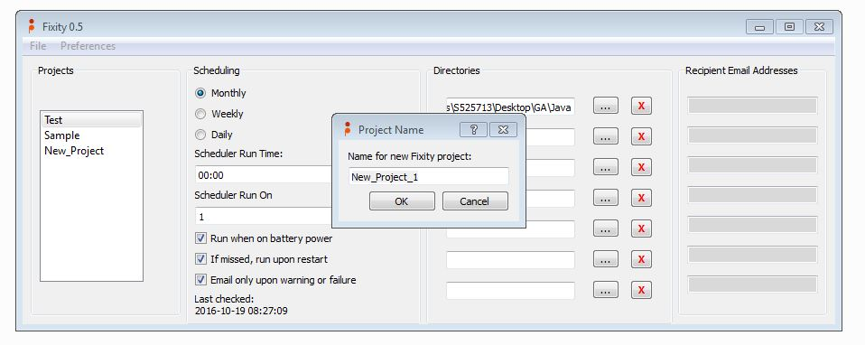
Creation of Project

Slide 18
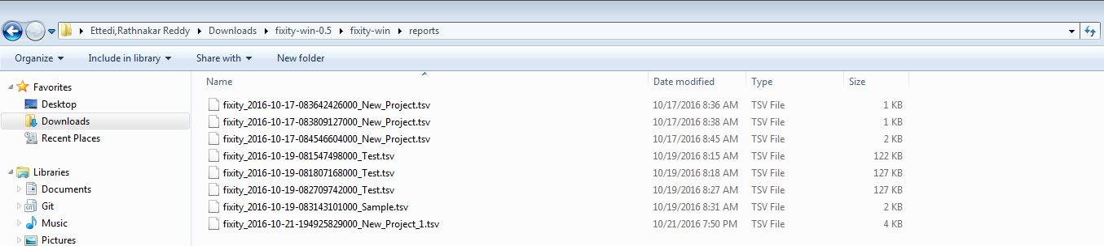
Destination of the report folder

Slide 19
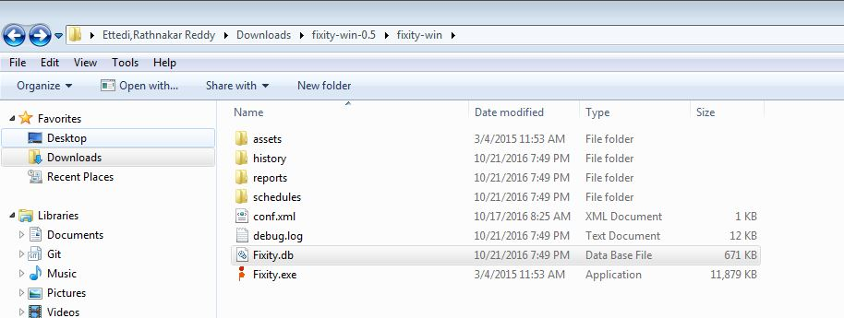
How fixity maintains the report

Slide 20
Use Case – Retrieve from DB

Slide 21
Use Case - Retrieve from File

Slide 22
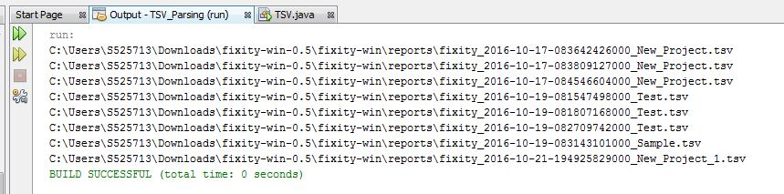
Java - Fetching Report
import java.io.IOException;
import java.nio.file.*;
import java.util.stream.Stream;
/**
*
* @author s525713
*/
public class TSV {
/**
* @param args the command line arguments
* @throws java.io.IOException
*/
public static void main(String[] args) throws IOException {
// TODO code application logic here
try (Stream<Path> paths =
Files.walk(Paths.get("C:\\Users\\S525713\\Downloads\\fixity-win-0.5\\fixity-win\\reports"))) {
paths.forEach(filePath -> {
if (Files.isRegularFile(filePath)) {
System.out.println(filePath);
}
});
}
}
}

Slide 23
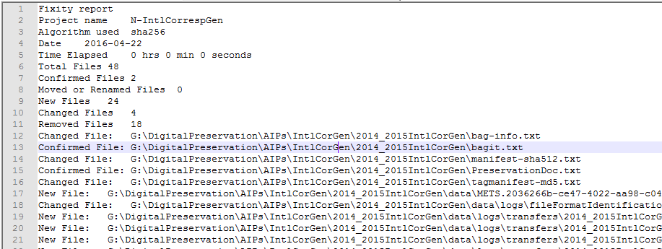

uniVocity - Parsing Report
uniVocity-parsers
Report
Parse
List

Slide 24
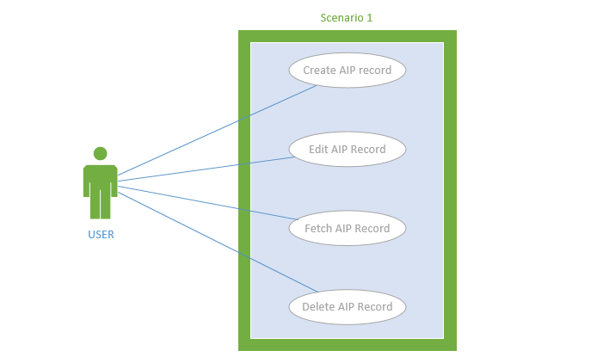
Use Cases of Database

Slide 25
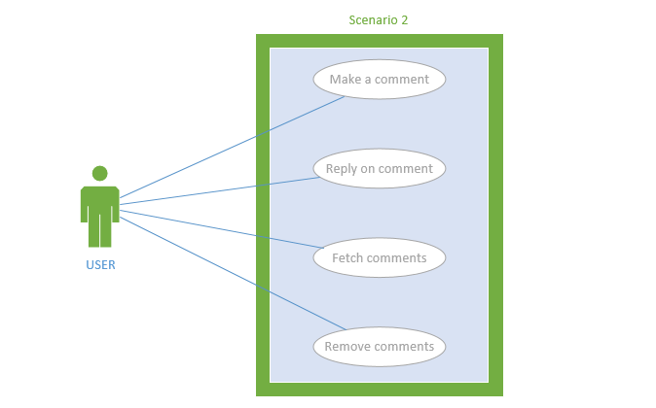
Use Cases of Database

Slide 26
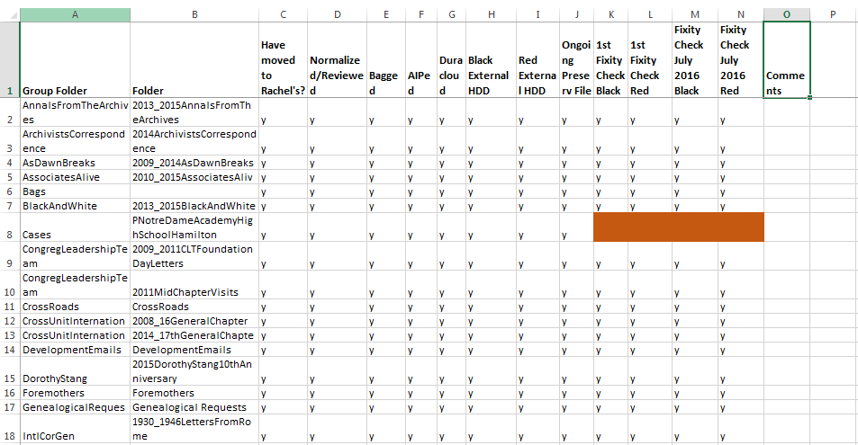
AIP Records Management

Slide 27
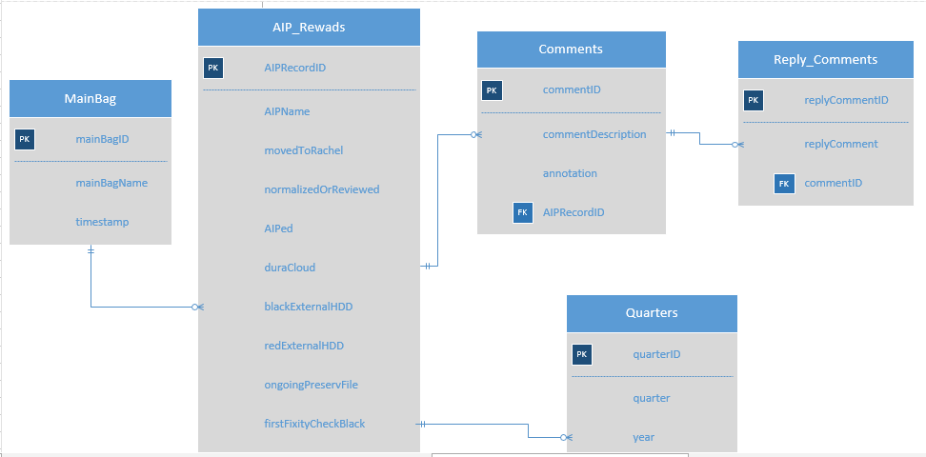
ER Diagram of Archival Database

Slide 28
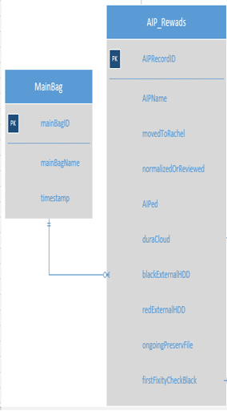
Normalizing Into 2NF

Slide 29
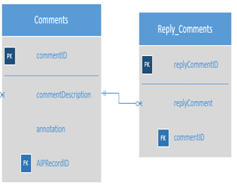
Normalizing Into 3NF

Slide 30
Sample AIP Methods
createAIPRecord ()
Syntax: createAIPRecord (int aipRecordId, String aipName, int mainBagId, int commentID, int quarterID, bool movedToRachel, bool normalizedOrReviewed, bool aiped, bool duraCloud, bool blackExternalHdd, bool redExternalHdd, bool ongoingPreserveFile, bool firstFixityCheckBlack, bool firstFixityCheckRed)
editAIPRecord()
Syntax: editAIPRecord (int aipRecordId, String aipName, int mainBagId, int commentID, int quarterID, bool movedToRachel, bool normalizedOrReviewed, bool aiped, bool duraCloud, bool blackExternalHdd, bool redExternalHdd, bool ongoingPreserveFile, bool firstFixityCheckBlack, bool firstFixityCheckRed)

Slide 31
Sample AIP Methods
getAIPRecord()
Syntax: getAIPRecord (int aipRecordId)
deleteAIPRecord()
Syntax: deleteAIPRecord (int aipRecordId)
getLatestFixityReportName()
Syntax: getLatestFixityReportName (Datetime timestamp)
removeLatestFixityReportName()
Syntax: removeLatestFixityReportName (Datetime timestamp)

Slide 32
Sample AIP Methods
removeLatestFixityReportName()
Syntax: removeLatestFixityReportName (Datetime timestamp)
getComments()
Syntax: getComments (int aipRecordID)
postComments()
Syntax: postComments (int aipRecordID, String commentDescription, String annotation)
editComments()
Syntax: editComments (int aipRecordID)

Slide 33
Sample AIP Methods
removeComments()
Syntax: removeComments (int aipRecordID)
getReply()
Syntax: getReply (int replyCommentID)
postReply()
Syntax: postReply (int replyCommentID, String replyCommentDescription, int commentId )

Slide 34
Sample AIP Methods
editReply()
Syntax: editReply (int replyCommentID)
removeReply()
Syntax: removeReply (int replyCommentID)

Slide 35
THANK YOU ☺

